Slide 1




Apache Footwear India Private Limited
The Systematic Conversion of Planning Schedule Data
Report Presented
Presented by : Manohar-G ( APC-IT )
2025 November 17

Slide 2

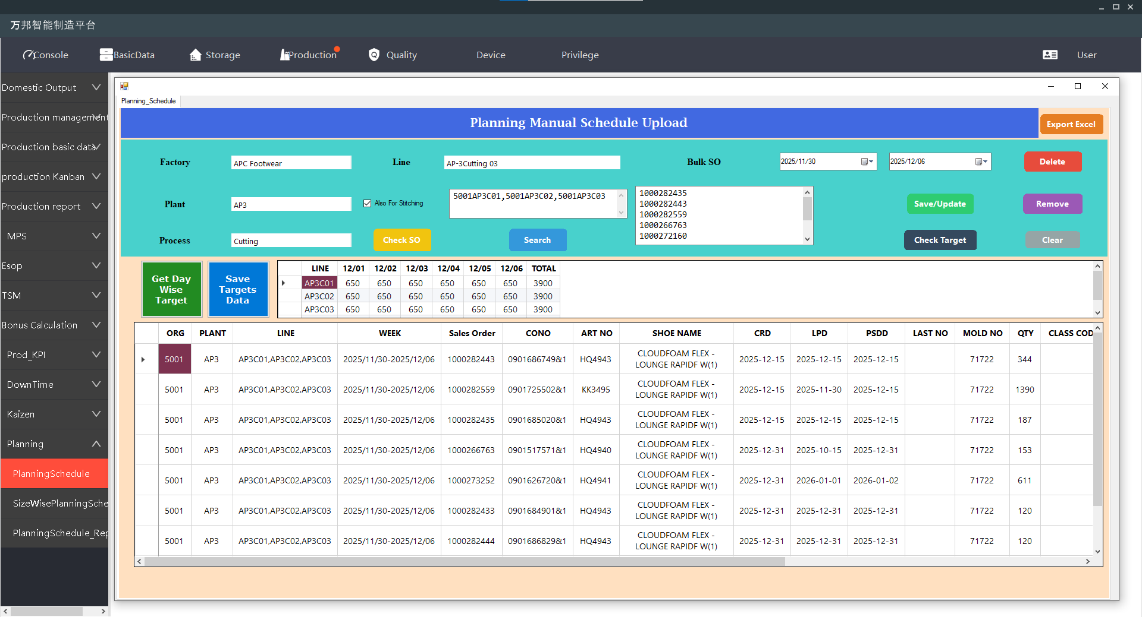
Planning Schedule Save And Modification And Deletion Form

Slide 3
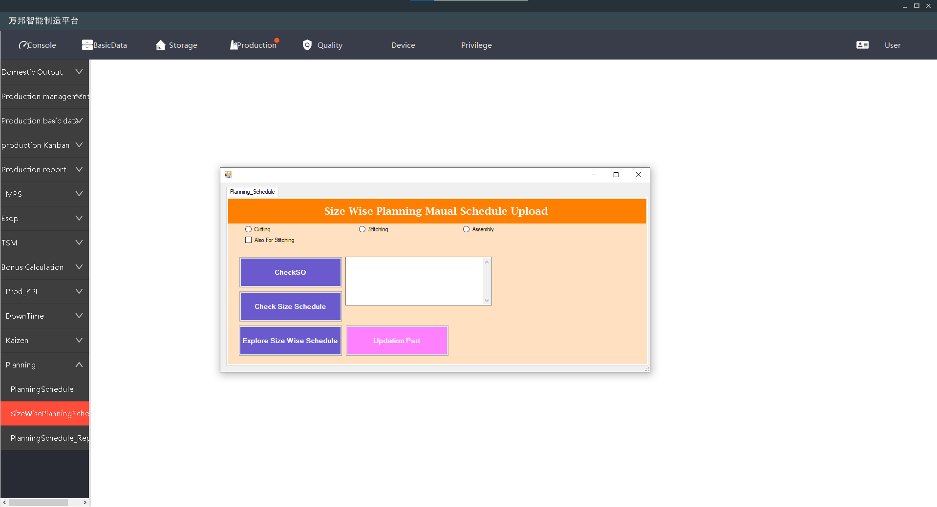
Size Wise Planning Schedule Checking And Explore Process

Slide 4
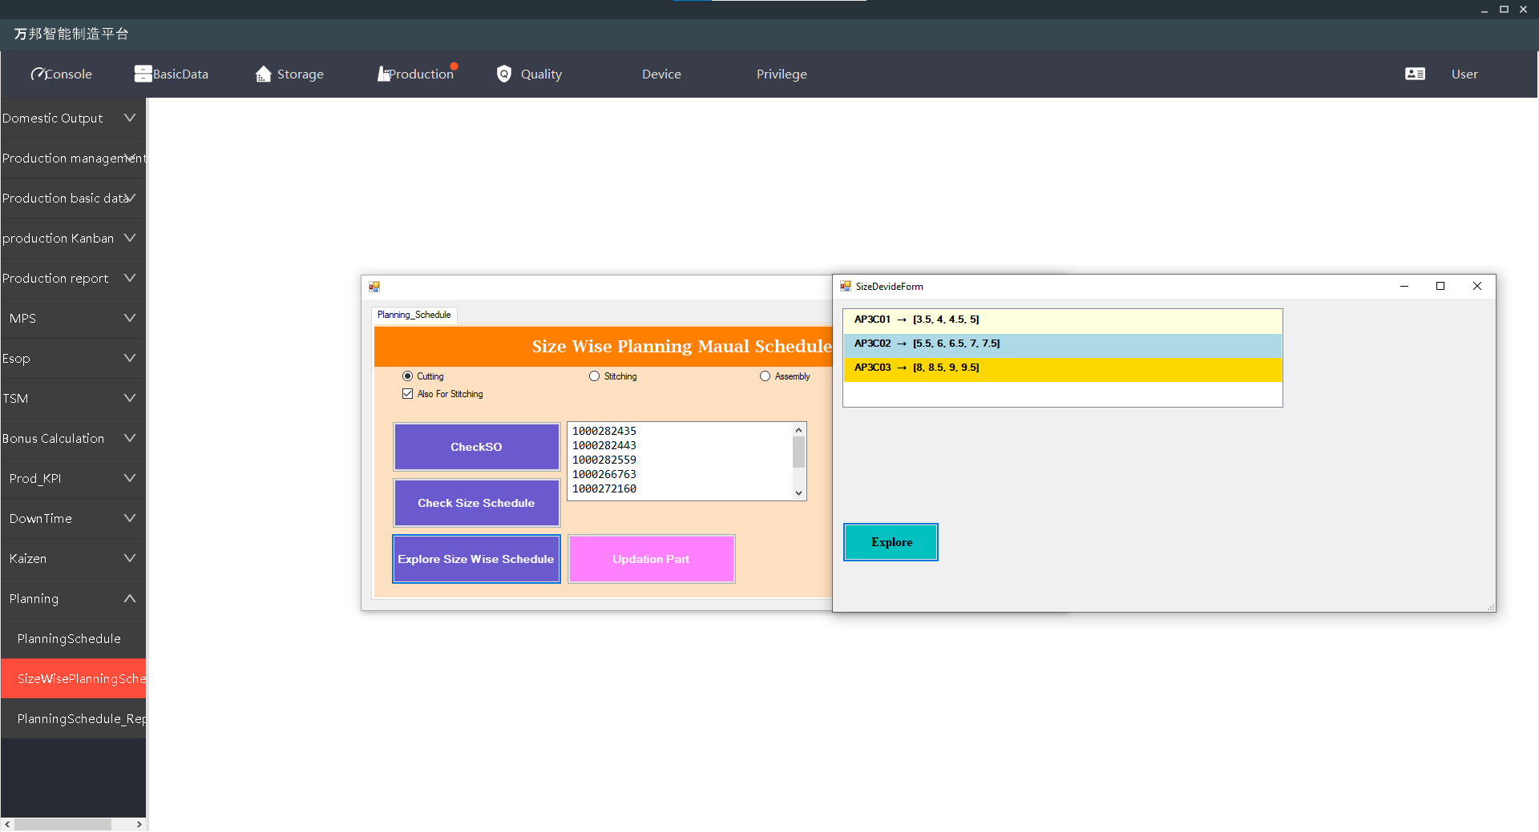
Size Wise Planning Schedule Size Allocation Process

Slide 5
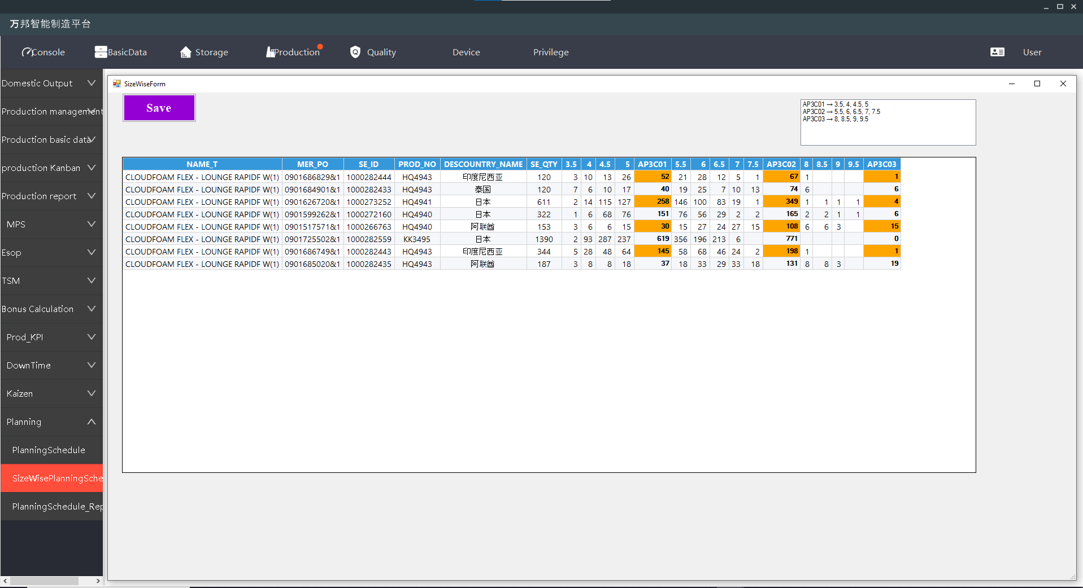
Save the Size Wise Planning Schedule Data

Slide 6
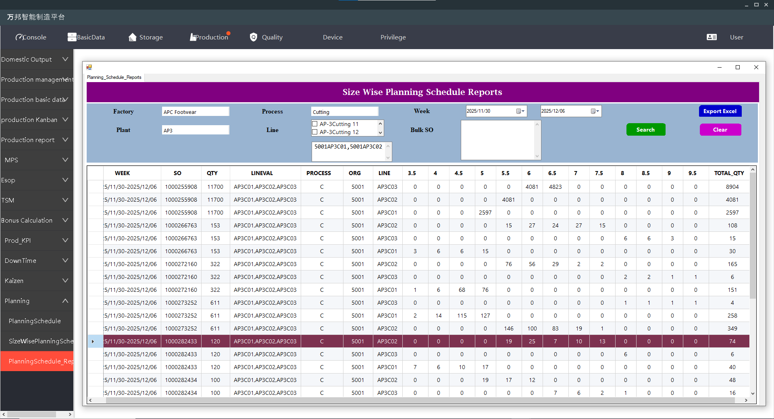
Data Checking of Size Wise Planning Schedule Process

Slide 7
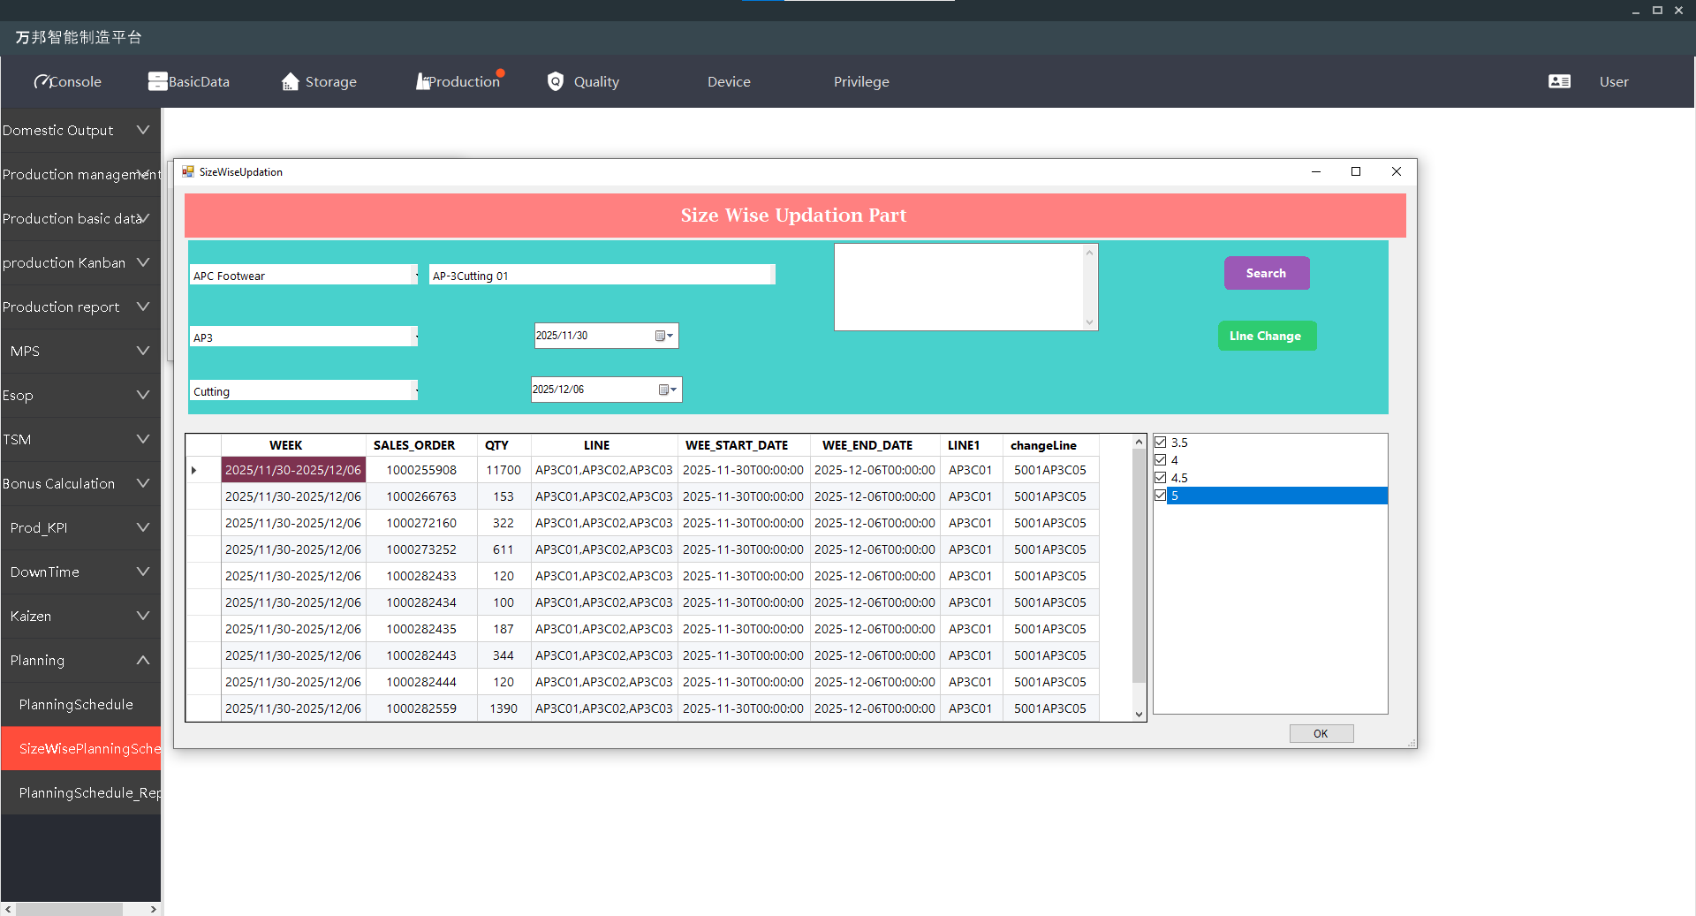
Line Change Process In Size Wise Planning Schedule

Slide 8




